Slide 1
GIT
A Simple Tour of

Slide 2
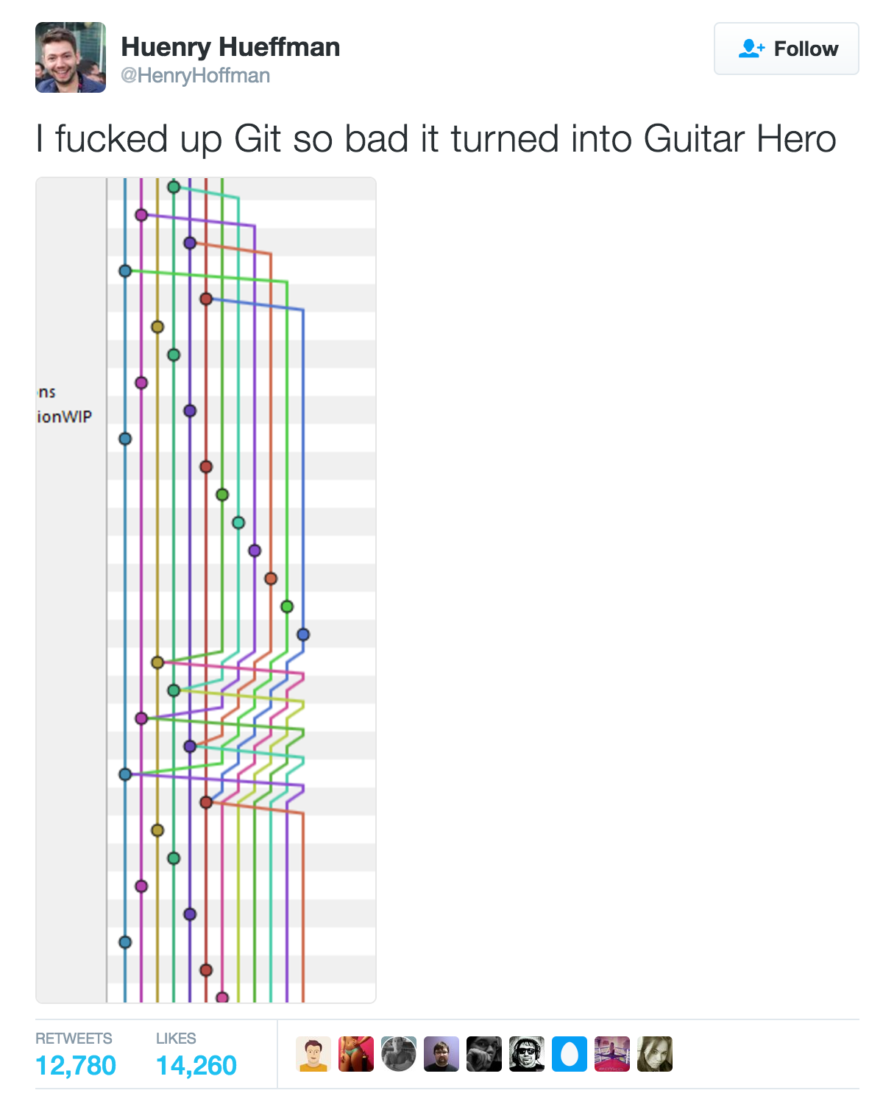
is musical
Git

Slide 3
What’s Good about Git
distributed system
fast
nearly every operation is local
branching is so cheap (absolutely awesome)
can’t be fooled (check-summed)
able to handle large projects like the Linux kernel efficiently (https://github.com/torvalds/linux)
the name is easy and short

Slide 4
Initialise A REPO
create a directory
navigate to the directory
git init

Slide 5
Make a Commit
git add - to stage the files you want to commit
git commit - to actually commit your changes
be careful: un-staged files won’t be committed

Slide 6
Push Your Repo
git remote add origin https://github.com/rui-infotrack/git-demo.git
git push -u origin master
-u, which is —set-upstream, means to make your local master branch to pull from/push to origin/master branch
now origin/master is your upstream
git remote -v

Slide 7
PUll
why is it called pull?
git pull is actually 2 commands
git fetch
git merge origin/develop
don’t be afraid of resolving conflicts (seriously, 80% of the time, you can resolve them without touching any tools)

Slide 8
MERGE
checkout the branch you want to merge to (e.g. git checkout master): git checkout master
use git merge develop to merge develop to master
what does origin/develop mean?
delete local branch after merging: git branch -d branch
reminder to myself: you should now show a demo regarding conflict resolving

Slide 9
Cherry pick & Rebase
sometimes you can’t merge the whole branch because it might be problematic
checkout the branch you want to cherry pick to
use git cherry-pick commit-hash to apply the exact commit

Slide 10
Rebase
you have been working on a local branch for 1 month
you want to be sync with origin/develop again
so you first git checkout develop and pull from remote repo
then you git checkout my-feature
last, you do git rebase develop
alternatively… create a new branch from develop and merge your feature branch to that

Slide 11
GitFlow (how we release)
people create feature branches from develop branch
people create hotfix branches from master branch
people merge their branches to develop branch
at 11am, a release branch is created from develop branch
release branch is daily release candidate. commits can be made to it.
after testing, we release the release branch
captain merge release branch back to master branch and develop branch
push everything and tag the release (e.g. git tag 1.5.1)
kindly, xinxin wrote this documentation (see next slide for the link)

Slide 12
sorry, the link mentioned previously is just too long to fit, so here it is:
https://infotrackhome.sharepoint.com/development/_layouts/15/WopiFrame.aspx?sourcedoc=%7B35FB87CA-2339-43D1-B0BA-6EFE0D39F222%7D&file=Git%20Workflow.docx&action=default
…well, if you can remember this link, i’ll get you a job in CIA
also, rui, you might want to show a simple demo for our gitflow

Slide 13
Tips
set up your git alias
no direct commits - create your feature branch
git stash, git pull, git stash apply
git reset —hard origin/develop
breathe freely - learn how to use Git everywhere
write your own shell script to enhance your efficiency
ask: http://explainshell.com/
advertisement - http://syd-schrpt01-l/devman

Slide 14
Questions

Slide 15
Until Next Time

